Slide 1
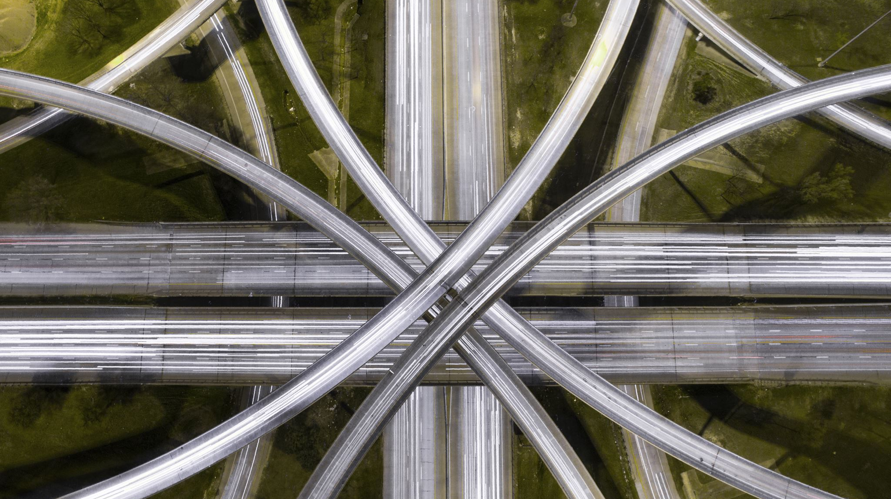
Autonomous Intersection Management (AIM)
By: Team Trier Charles Arsenal Okere(Charles) Muhammad Amirul Hakimi bin Zaprunnizam(Amirul) Muhammad Iqbal bin Mohd Fauzi(Iqbal) Muhammad Farid Izwan bin Mohamad Shabri(Farid) Muhammad Amjad bin Abdul Malik (Amjad)

Slide 2
Problem?
Car crashes at intersection point or junction without traffic controls.
Time wasted
Emission
Heavy Traffic

Slide 3
Introduction
We began this research by outlining the most common technology used to solve the problem
Signal optimization with real-time CAV trajectory information
FCFS and BATCH approach

Slide 4
MOTIVATION
A lot of studies have been done on a wide range of subjects.
Our topic requires us to conduct studies on a certain issue to and to acquire a generative notion about the automation intersection management which allows us to get interested in new ideas and approaches.

Slide 5
Solution
V2V Protocol = Share datas between one vehicle to another for example speeds,
Total Bandwidth Server Algorithm = Scheduling aperiodic task
Vehicle Collision Warning Communication Protocol
Management Centre/Server Hub to send information
Fcfs

Slide 6
Design
Activity Diagram
State Machine Diagram
Sequence Diagram
Use |Case Diagram

Slide 7
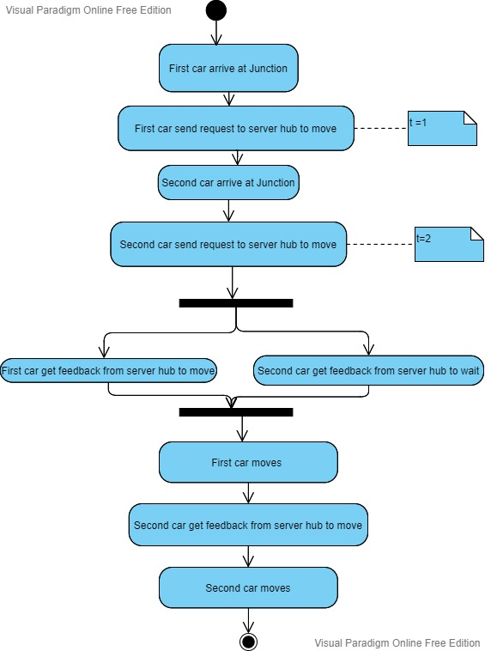
Activity Diagram for car scenario

Slide 8
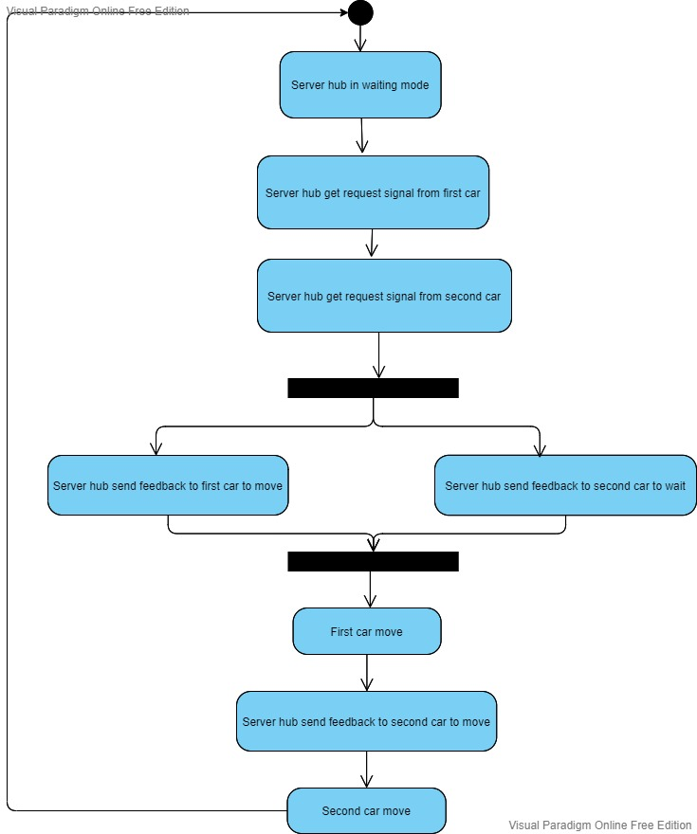
Activity Diagram for server hub

Slide 9
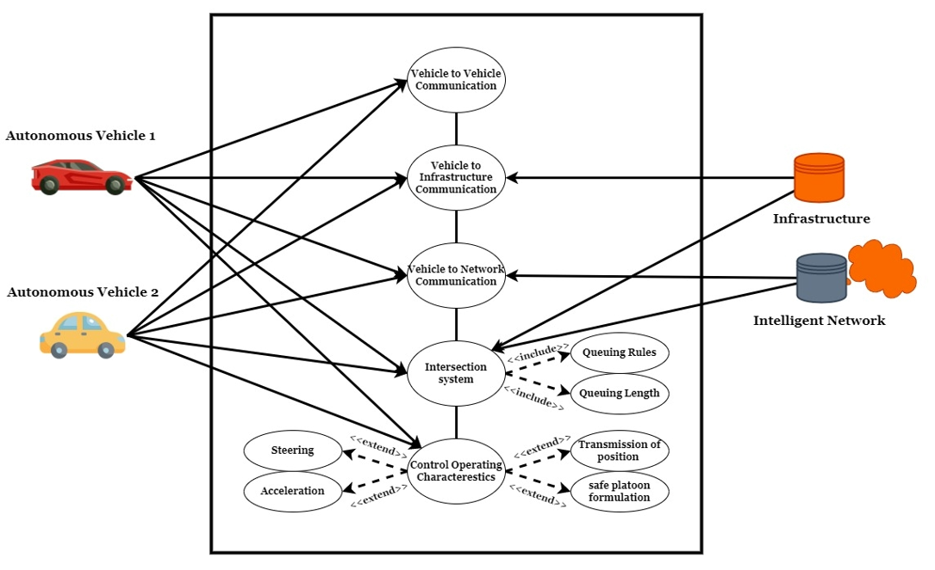
Use Case Diagram
To attain the aim of a totally autonomous driving car, the robot vehicle must have a thorough understanding of its surroundings.
Information that is required is based on onboard sensors which includes
1. Vehicle to Server Hub
2. Vehicle to Intelligent Network

Slide 10
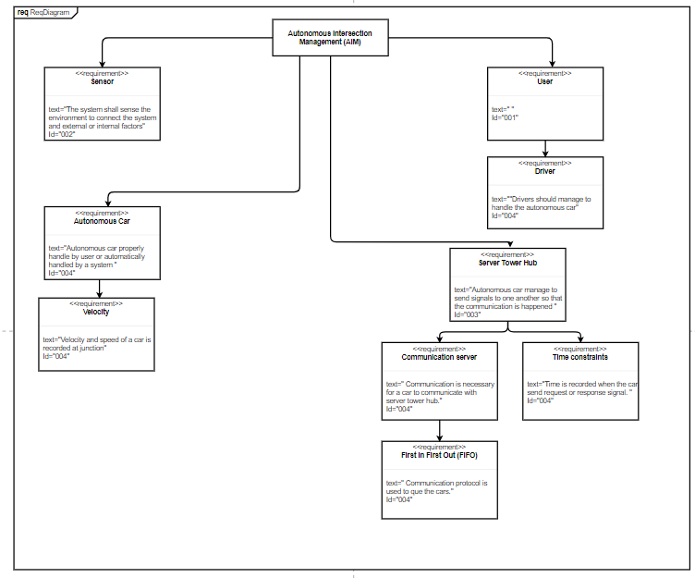
Requirement Diagram

Slide 11
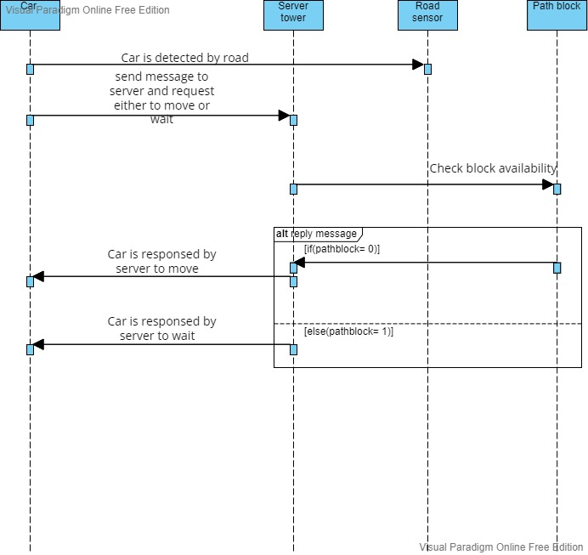
Sequence Diagram

Slide 12
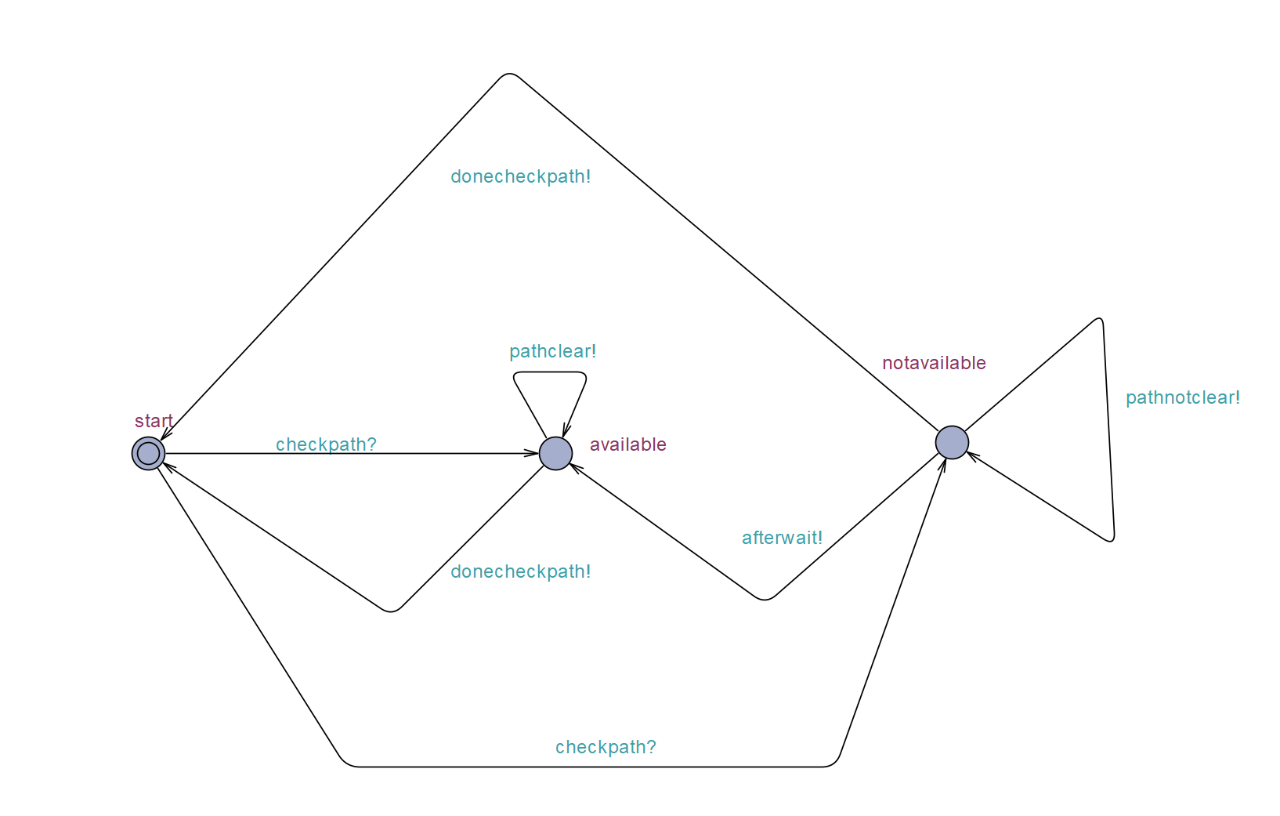
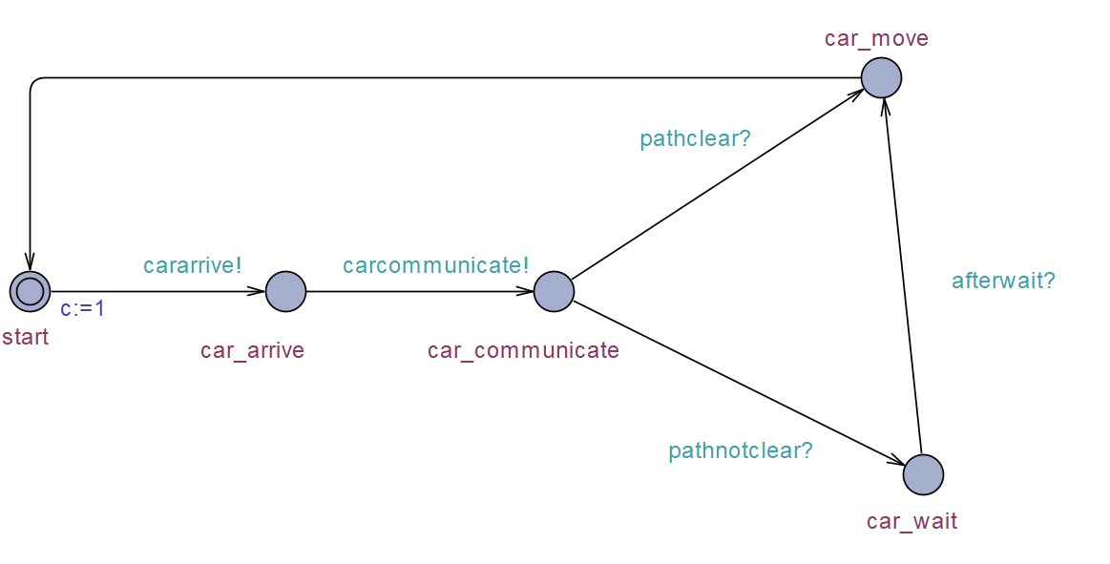
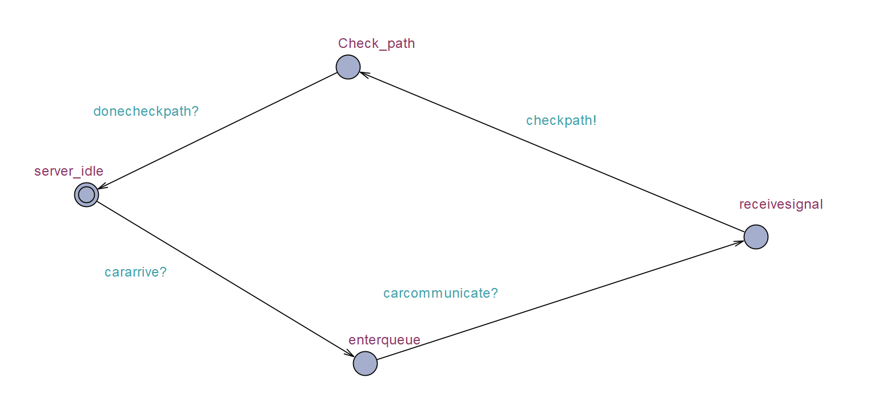
UPPAAL
Car State
Server State
Path State

Slide 13
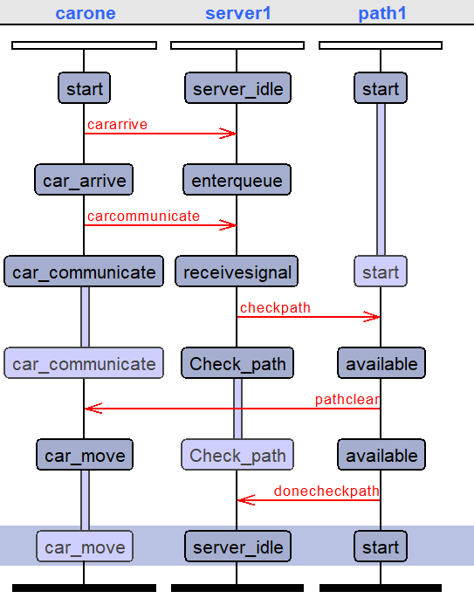
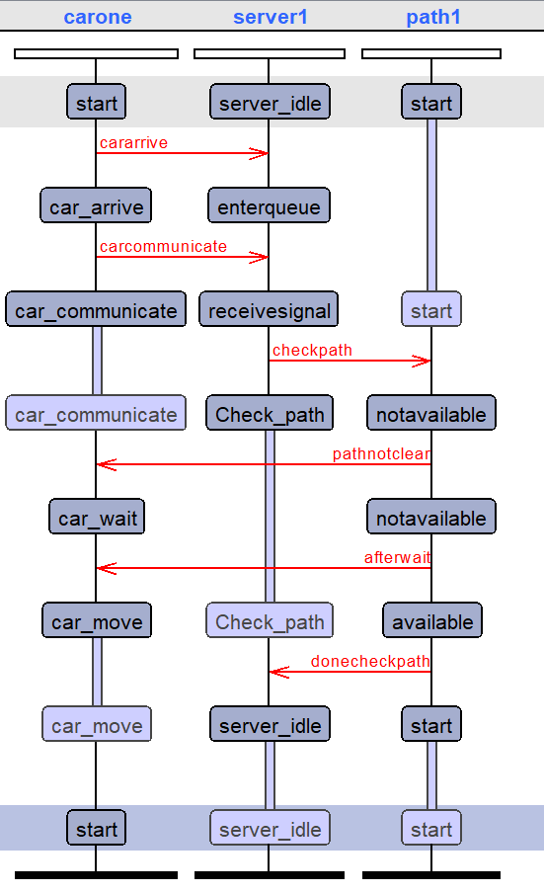
Simulation

Slide 14

Implementation

Slide 15
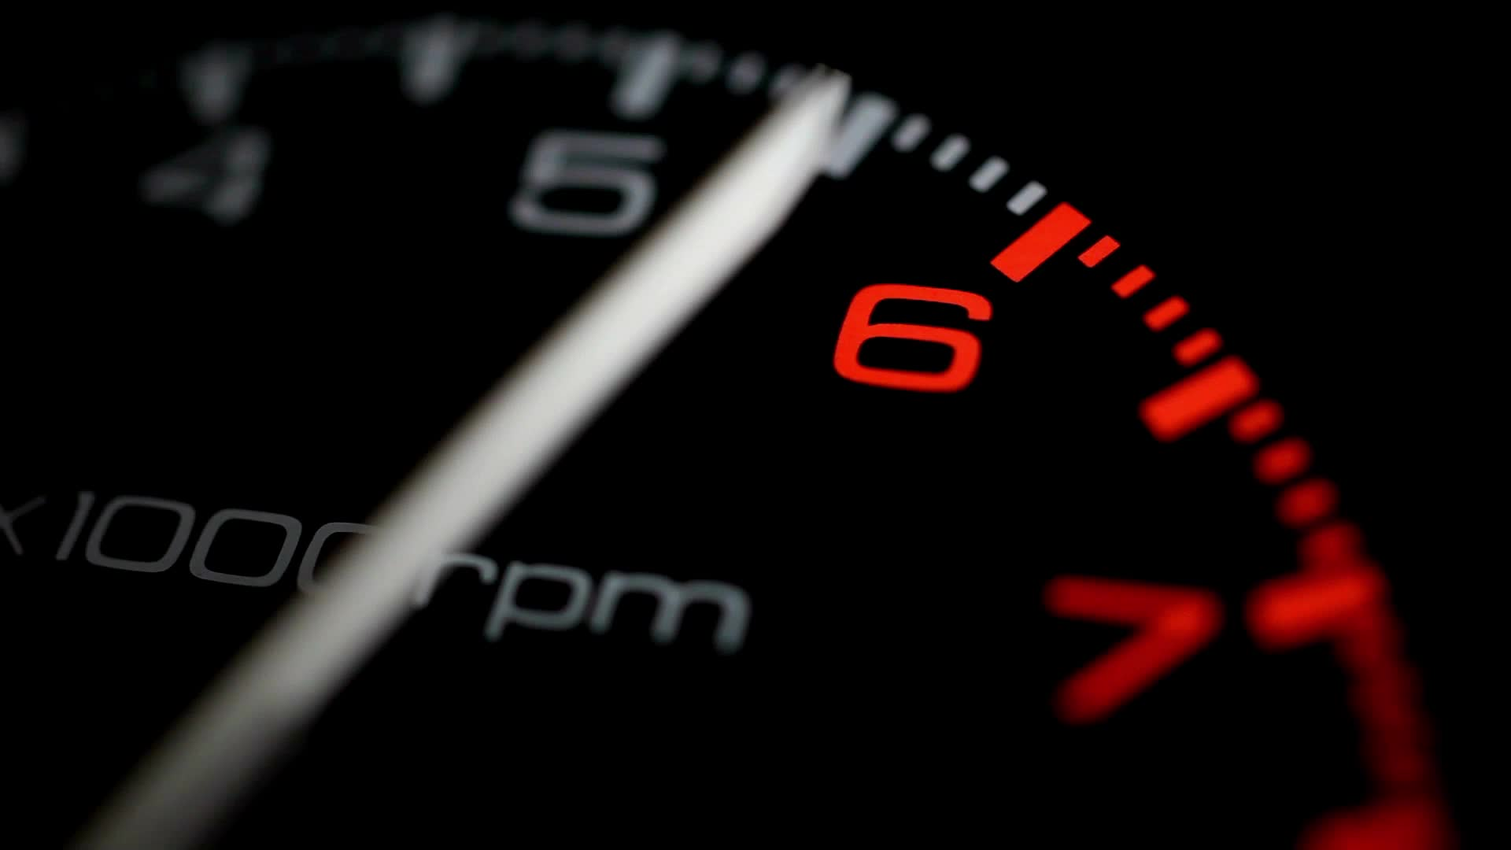
Real Time Operating System(RTOS)

Slide 16
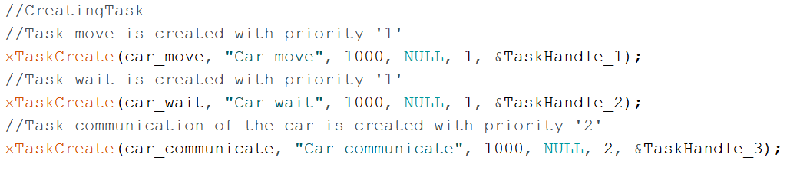
Create Task
car_communicate = priority “2”
car_wait = car_move = priority “1”
Priority 2 > Priority 1

Slide 17
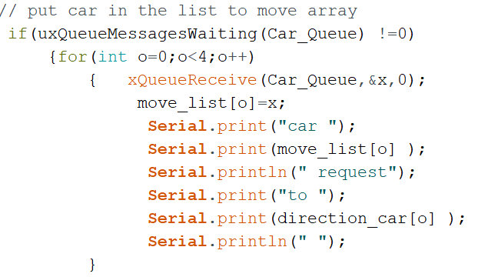
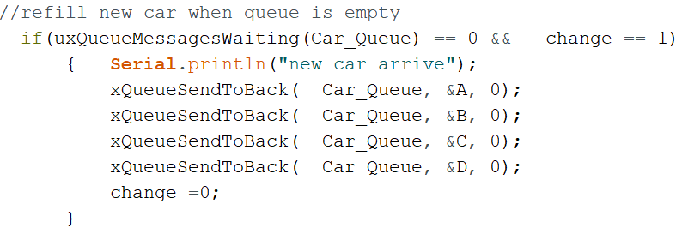
Queue Management
Task Communication

Slide 18
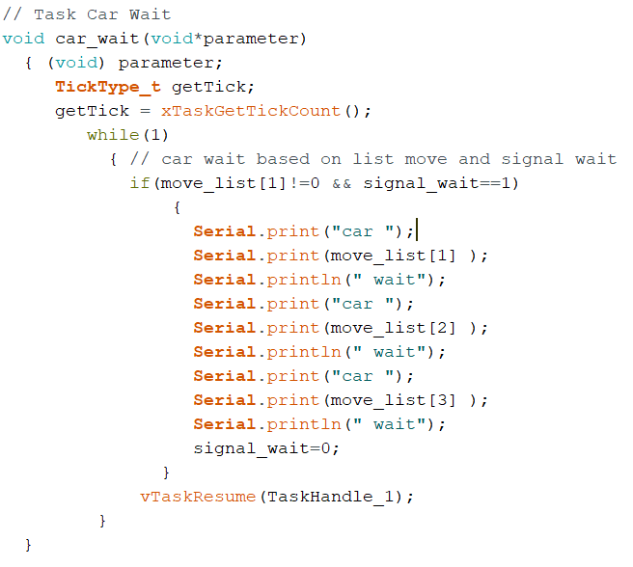
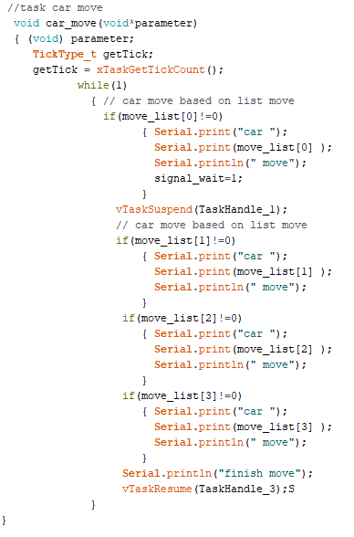
Concurrency

Slide 19
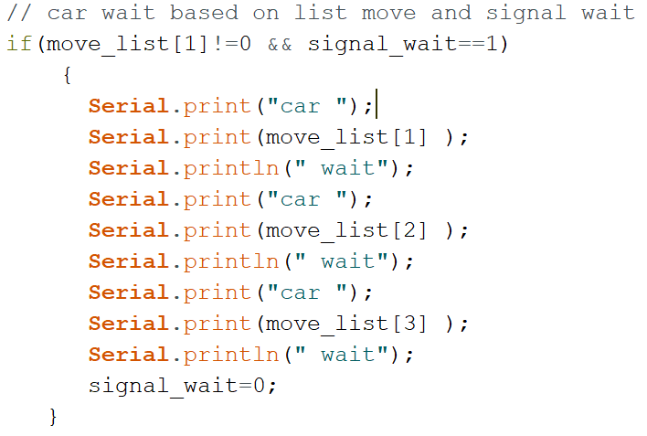
Wait Management
Car Wait Task

Slide 20
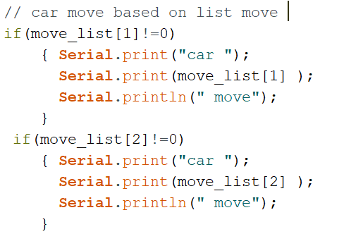
Moving Management
Car Move Task

Slide 21
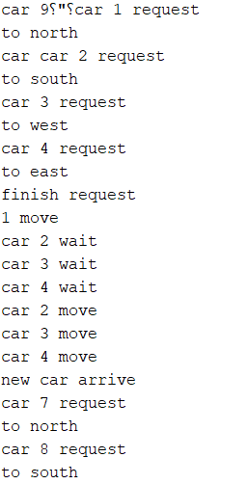
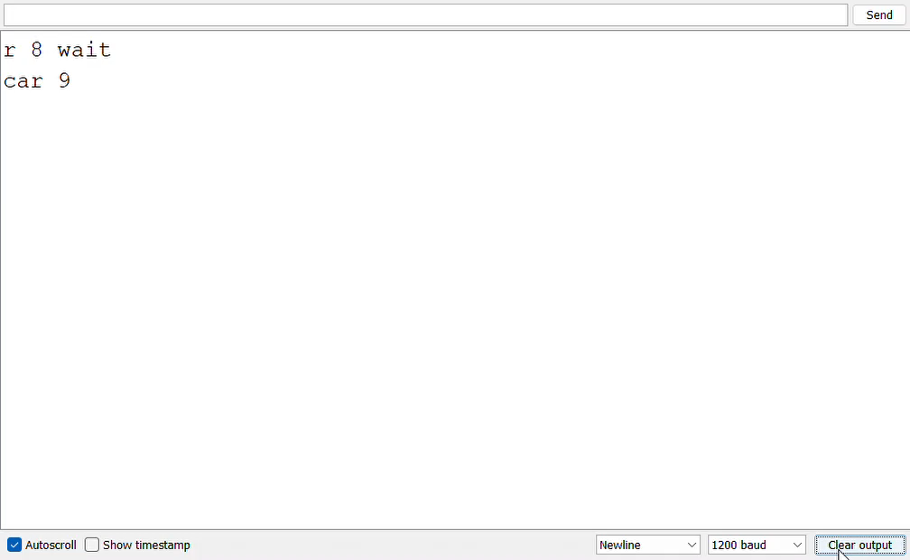
Result

Slide 22

VHDL

Slide 23
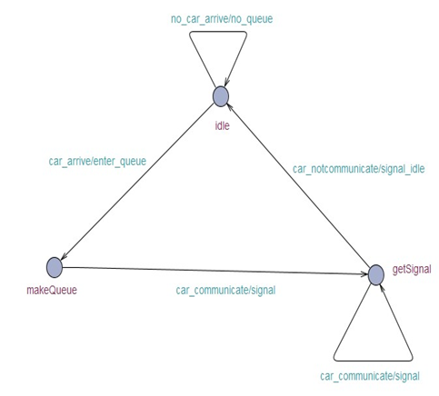
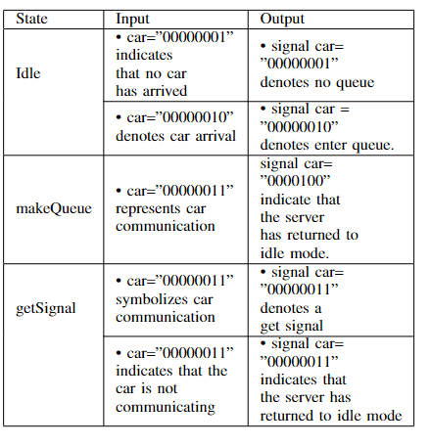
Finite State Machine (FSM)
Communication between car and server
Three state :Idle, makeQueue,getSignal

Slide 24
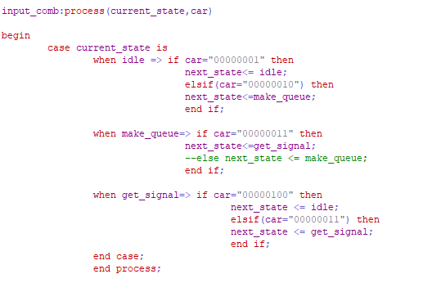
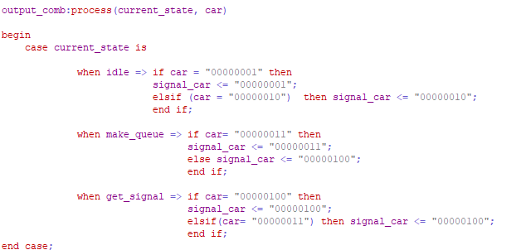
Input and Output

Slide 25
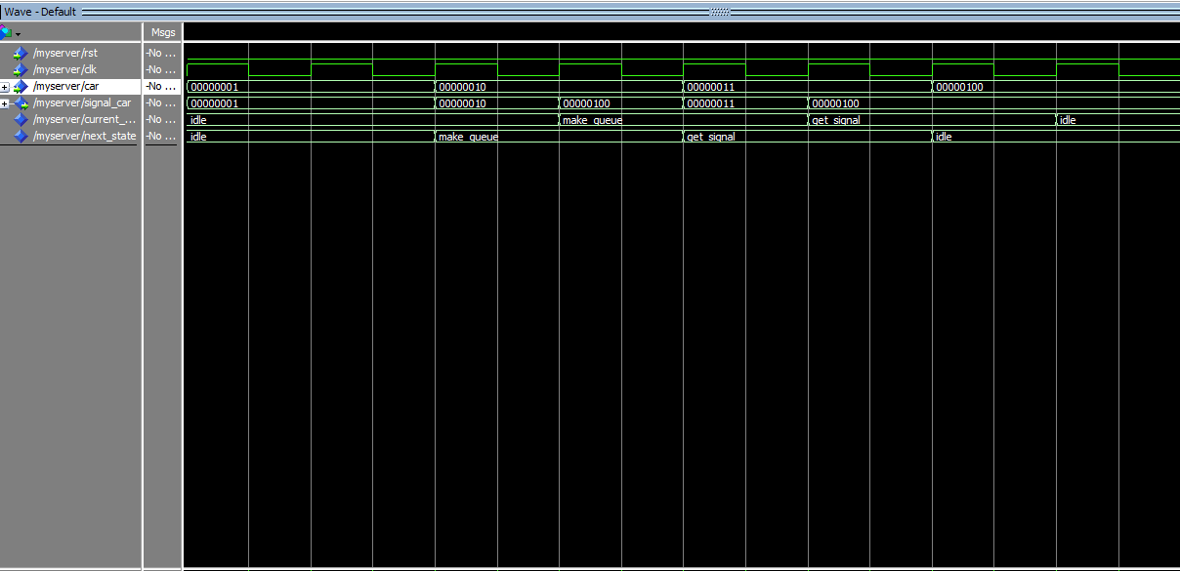
Result

Slide 26

Thank you

